Slide 1

Schematics And Layout Guidelines
Moris Ruso REV-J
1.5.25

Slide 2
Changes History
Version | Date | Change description | Comments
A | 15.02.18 | Initial document
B | 07.07.19 | 1. Thermal reliefs calculations 2. Keeping 120mil from TH pin on PS to ICT and TPs 3. Via minimum drill diameter as per board thickness 4. ATE changes 5. ICT changes
C | 16.07.19 | Changing to new SE PPT template
D | 07.01.20 | Adding handles for big boards Via covering with Solder mask
E | 10.08.20 | MLCC capacitors direction
F | 04.08.21 | Avoid placing components on weak areas
G | 02.08.23 | 12mil and 15mil vias are covered with SM from both sides Better to place components on one side of the board.
H | 11.9.23 | Add TH laser and robotic soldering requirements

Slide 3
Changes History
Version | Date | Change description | Comments
I | 15.01.24 | Change distance between ICT TPs to 55mil+distance from high components Approved Screws and standoffs footprints Press fit components requirements Design for automation Laser soldering requirements Robotic soldering requirements Thieving pads 2D Barcode Fiducials
J | 1.5.25 | Fiducials Panelization 2D Barcode

Slide 4

Purpose
The purpose of this meeting is to align the layout procedure for all SolarEdge’s engineers and teams.
We determined simple key guidelines in order to save time and improve the layout process.
When many changes in the design are done during the layout, it can’t be optimal, and it takes much more time.
Our goal is to make a single, short and good layout, which designed well.

Slide 5
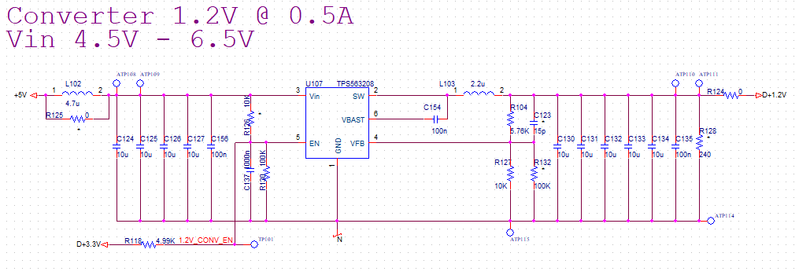
Designing the DSN
General
Manage schematics revisions.
When you drew the DSN, make sure that you work with grid on, in order to prevent misconnections.
The flow of the page is generally from left to right.

Slide 6
Designing the DSN
General
Ref Des will be defined as follow:
  Resistor - Rxxxx
  Capacitor - Cxxxx
  Diode - Dxxxx
  Zenner – Zxxxx or ZDxxxx
  Transistor - Qxxxx
  Inductor - Lxxxx
  Transformer – Txxxx
  IC - Uxxxx
  Relay - Kxxxx
  Varistor - VRxxxx
  Connector – Pxxxx or Jxxxx
  ATE TP - ATPxxxx
  R&D TP – TPxxxx

Slide 7
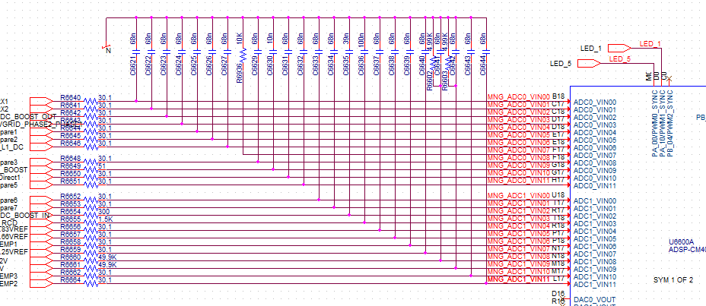
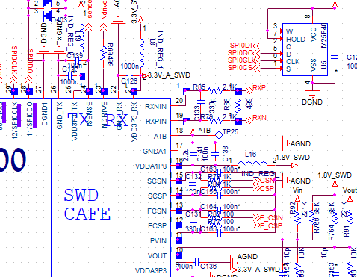
Designing the DSN
General
In order to avoid changes, make sure that the components you choose are available to buy, have second sources and that they are not too expensive.
Make sure to insert all the components from Solaredge’s database. If there is a missing part, please ask component engineer to add it. By doing so, the component engineer will check the component price, availability and the footprint will be ready for you when you start the layout.
When you draw the DSN, please make sure that all the texts are readable, do not overlap each other and REF_DESs are close to the component they belong to.
Preferred

Slide 8
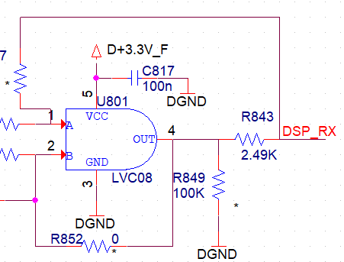
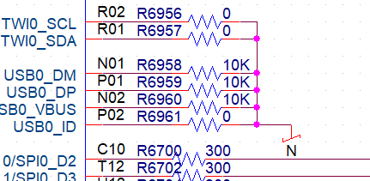
Designing the DSN
General
Make sure that all the components’ connections are always through wires. Do not connect component from one to the other without adding a wire between them.
Do not connect component to Junction without adding a wire between them. In this way, you will get dot on each junction, and it will be easier to see misconnections and unwanted shorts.
Preferred

Slide 9
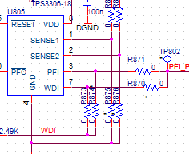
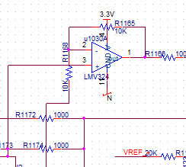
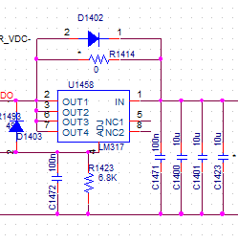
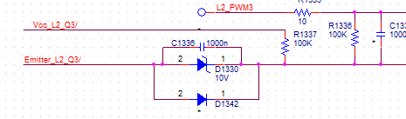
Designing the DSN
General
Do not drew wires threw components.
When you have junction which has connections from 4 directions, do not connect them as cross. In a cross it is hard to know if the connection is a mistake.
Preferred
Preferred

Slide 10
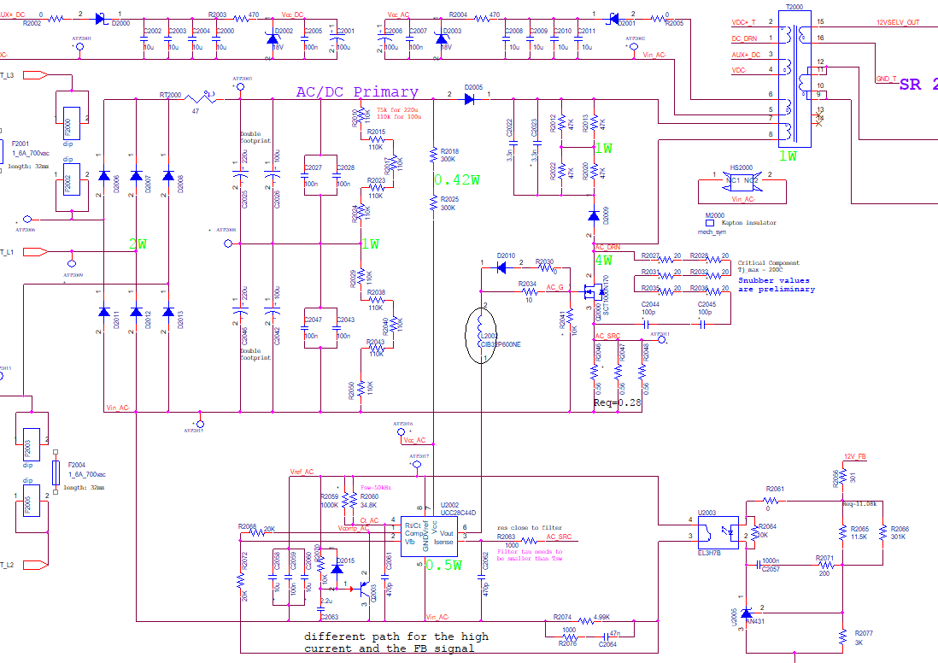
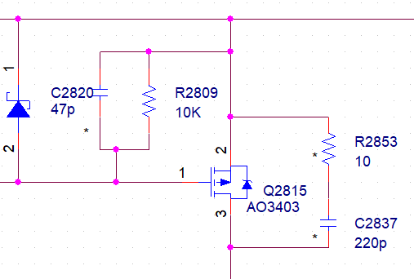
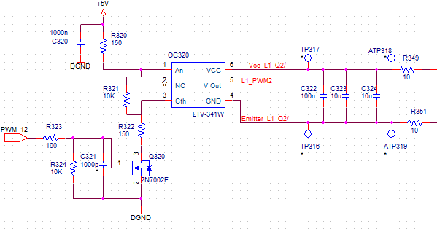
Designing the DSN
General
In the DSN, place the components and TPs where you want them to be placed on board. For example, filter capacitor near the IC pin it should filter, capacitor closer than the resistor, Vcc capacitor near the ICs Vcc pin and so on. In that way, it will be easier to understand the DSN and the purpose of each component. In addition, the layout designer will know better where to place the components.
Preferred

Slide 11
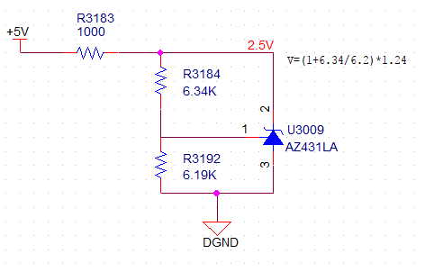
Designing the DSN
General
Make sure that all the ICs have Vcc capacitors with value that recommended at the datasheet (usually 100nF).
Make sure that you put capacitors over reference voltages.
There is no capacitor to stabilize the Ref voltage

Slide 12
Designing the DSN
General
If you use labels in the DSN, make sure that the label is identical for both sides. You can do that by copy the label from one place to the other. Net name cannot be implemented with spaces inside the name, separate words with (_).
Try to avoid too many labels. It is difficult to understand the DSN flow.
Once layout started, do not change components Ref Des. If you need to change their value, make sure to keep the original Ref Des and component orientation.
Suit your discrete component sizes to the IC they are connected to. Unless there are no power/voltage/other constraints do the following:
  For fine pitch IC, use 0603 or 0402 footprints.
  For QFP use 0402 footprints.
  For BGA use 0402 footprints with alternative symbol for round pad (to use under the component between the VIAs).
  Do not use different sizes of components at the same circuit unless it is necessary.

Slide 13
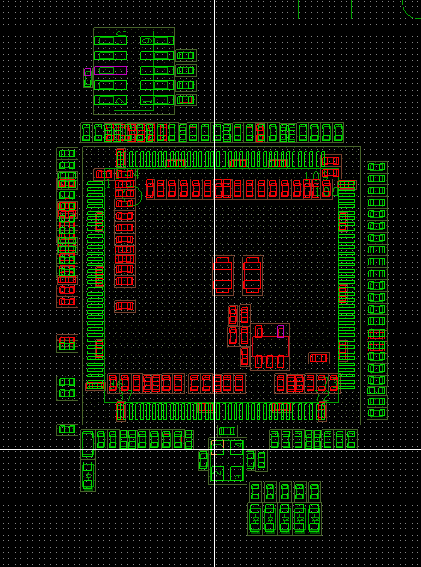
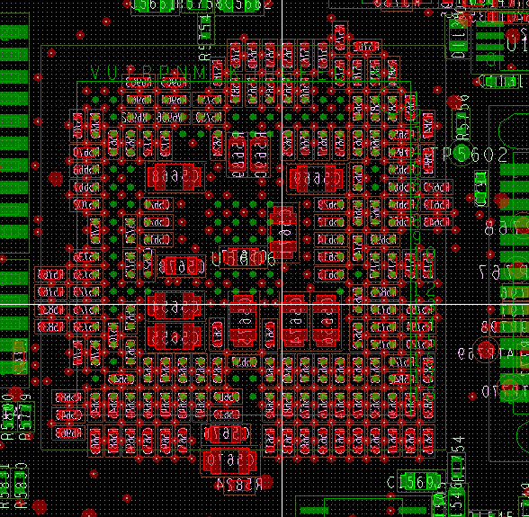
Designing the DSN
General
Example for components selection:

Slide 14
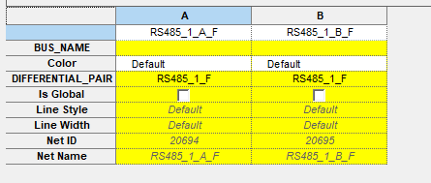
Designing the DSN
General
In the schematics Vcc should always be on top and GND on bottom side of the Drawing. Do not mirror the components in order to switch, even if you make sure that you connected it right, because next time someone would like to change the component, he may not notice it and can connect the Vcc pin to GND and opposite.
If you have differential pairs in the DSN please add it to the DSN. Sometimes the differential signal contains a few nets. Make sure that you added it to the whole signal and not only part of it.

Slide 15
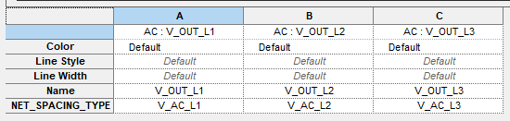
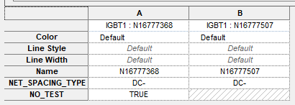
Designing the DSN
General
If there is high voltage on your board all the nets in the DSN must have Net Spacing Type. Make sure to fill it correctly in the “Main” page as well. Also, make sure that you give net spacing type for the not connected pins of the components.
If there are nets, which you do not want to add ICT such as amplifier inputs, FET’s gate, Clock and other sensitive nets, you should add true to the “NO_TEST” line.

Slide 16
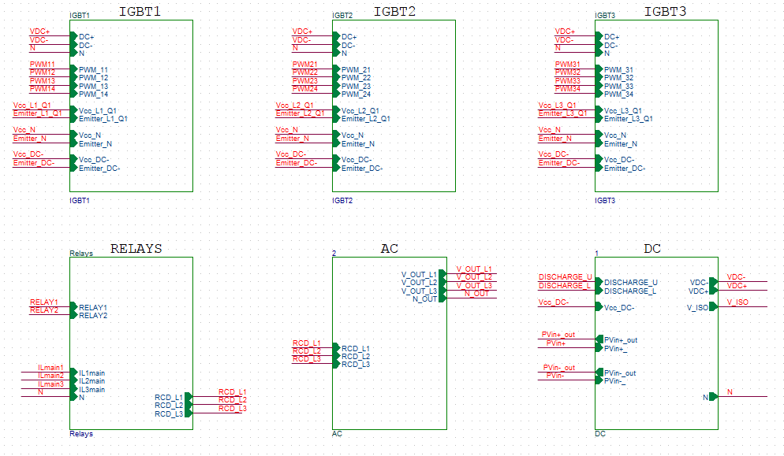
Designing the DSN
Working with blocks

Slide 17
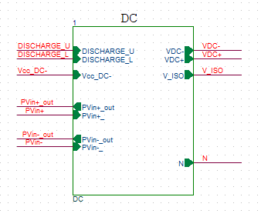
Designing the DSN
Working with blocks
When your DSN build from blocks, at the bottom of each block drawing, write the PCB PN, Block name and date.
Please number each block with other prefix. For example, Block1 X100-X199, Block2 X200-X299.
Please do not use large numbers with 4, 5 letters if you do not have to, it will be hard to place the component’s silks on the board, and we will have to delete them.
For block connections, make sure to use the correct hierarchical port. Use input for input and output for output.

Slide 18
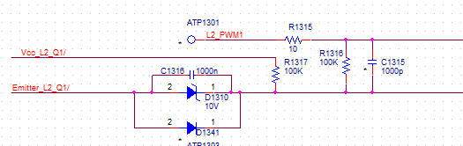
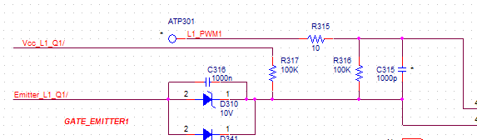
Designing the DSN
Working with blocks
It is better to connect between blocks in the main page (instead of giving each a name).
When you have identical blocks, please number them and make sure their numbering is differed by prefix only. In that way, it will be easier for layout and debug, and save lots of time.

Slide 19
Designing the DSN
Working with blocks
Make sure that every net in the main page has also Net Spacing Type, and that the Net Spacing Type you gave for each net matches the net Spacing type it has inside the block.

Slide 20
Designing the DSN
Test Points
For ATE test points there are few footprints available: ATE_TP_40, ATE_TP_60, ATE_TP_80, ATE_TP_120 and ATE_TP_160.
Each size is able to support different current:
  ATE_TP_40 – 1.5A
  ATE_TP_60 – 1.5A
  ATE_TP_80 – 1.5A
  ATE_TP_120 – 20A
  ATE_TP_160 – 50A
ATE TPs REF_DES should be ATPXXX. In that way, the layout designer will know that it is ATE TP and place it in the bottom side of the board.
For low power signals, the ATE team prefer to work with ATE_TP_60 footprint. We prefer the ATE_TP_40. The compromise is to use ATE_TP_40 with alternate symbol of ATE_TP_60 and use the bigger one when it does not damage the design.
For general and R&D use, please use SMT_TP_1 footprint (or SMT_TP_2 if a bigger one is needed).
General R&D TPs REF_DES should be TPXXX. In this way, the layout designer will know that it is R&D TP and place it in the top side of the board.

Slide 21
Designing the DSN
Screws
Do not use unplated footprints for screws or spacers because they should get net spacing type, even if they are not connected to chassis or other net.
There are approved footprint for screws M3-M6 for small and big washer. please don’t use other footprints:
There are approved footprints for spacers
If a through hole in the board is needed for a spacer, please use footprint:
  M3 Spacer: CUTOUT_9MM_8_5MM
  M4 Spacer: CUTOUT_10MM_9_5MM
  Please make sure to define a net spacing type for them, since the spacer may be PE or another net.
Screw size | SE/PN | Footprint | SE/PN | Footprint
M3 | M3_DIN433 | M3_3_5MM_7_82MM_P | M3_DIN125 | M3_3_5MM_8_8MM_P
M4 | M4_DIN433 | M4_4_5MM_10MM_P | M4_DIN125 | M4_4_5MM_11MM_P
M5 | M5_DIN433 | M5_5_5MM_11MM_P | M5_DIN125 | M5_5_5MM_12MM_P
M6 | M6_DIN433 | M6_6_6MM_13_3MM_P | M6_DIN125 | M6_6_6MM_14_3MM_P

Slide 22
Before layout
Before you start layout set a Design Review meeting to verify that the design is ok and that you did not forget anything in it. It is important to include all the relevant people and departments, since they sometimes change requirements at the end of the layout. During this stage, making changes is hard and the board layout will not be optimal.
You must print and check the complete DSN wire list (Go over each net of the DSN and check that every component you meant to connect is really connected and that there are no shorts in the DSN). The wire list can be done with two People. One of them must be the DSN designer.
You should have the .dsn file and three files, which creates when you do netlist: pstchip.dat, pstxnet.dat, pstxprt.dat.
For new layouts, make a block diagram in order to understand the connections and relations between the circuits. In power circuits and auxiliary, mark the maximum voltage and current. Mark important and sensitive signals such as Clock, PWM, Differential pairs, High-speed signals and so on.

Slide 23
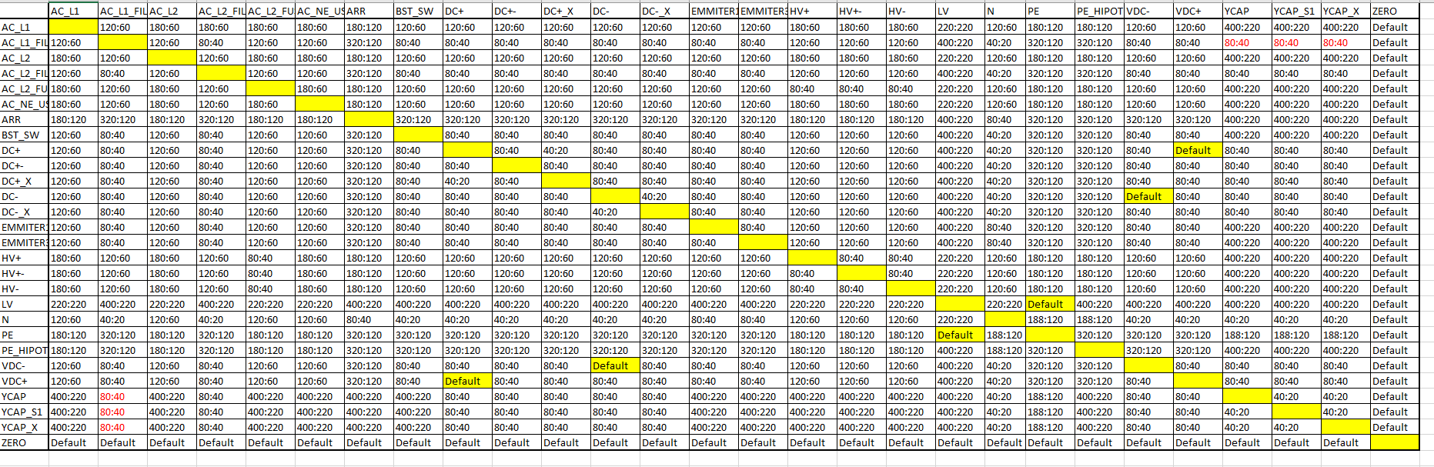
Before layout
You should make an Excel table, which consist all net spacing type groups and the distance between each one of them to the others in outer layers/ Inner layers. Please sort the groups in alphabetical order. It will save a lot of time.

Slide 24
Before layout
When the net spacing table is too big, It is possible to create a CSV file for net spacing for loading the net spacing distances automatically. It will save a lot of time.
You should have a DXF and PDF files of the board from mechanic team. Those files should contain the board outline, the location of screws and connectors, which cannot be moved during layout. The rotation of the connectors. Height limitations, component keepout and route keepout areas.

Slide 25
Starting layout
Load the DSN netlist.
Verify that all DRAs exist and updated and that the updated database library is in use.
It is recommended to update all DRAs prior to any re-layout.
Load a DXF file and create board outline. The board outline must be done from closed lines with no interrupts.
Create restricted areas as per PDF file: Height limitation keepouts, package keepout, route keepout and so on.
Load the constraint table if there is one.
If the layout is a version of an older board, please review the DFM report from the last version and decide which changes should be done.

Slide 26
Pre-Placement
For new project or projects where major change is needed sometimes, it is hard to decide about mechanical concept. In this case, it is recommended to make a pre-placement process.
For this process, you need an enough mature DSN but not a complete one.
It is better to set a DR before, with all the relevant people and departments in order to make sure that you have all inputs and feedbacks.
The pre-placement includes only placement (without routing) of the major circuits that have a big influence of the final board shape and size. There is no need to spend time for small circuits. You just need to make sure that you have the room for them.
When pre-layout is done and Mechanical concept is decided, you should take a break from layout and spend time for completing the DSN including net spacing type, Ref Des and so on…

Slide 27
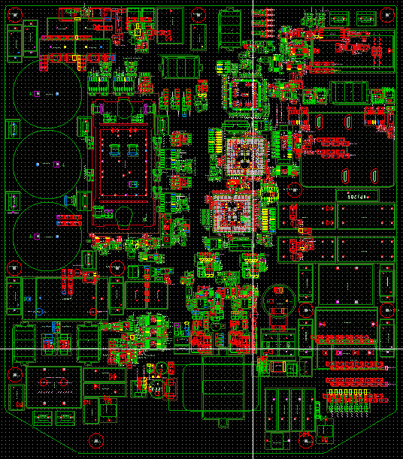
Placement
Place components By DXF (Connectors and screws that cannot move during layout).
Place high current circuits first and try to minimize the current paths.
Placement of groups outside the outline.
Place groups inside the outline. Separate different circuits such as power, digital, analog, auxiliary and so on. Separate sensitive signals from noisy signals.

Slide 28
Placement
Distance between components to PCB edge: 40mil.
All the components should be inside the outline 40mil from the board edge. If there is a component which protruding from the board edge to the panel, then need to enlarge the panel to have 200mil free of components.
Wave Soldering components on one side only unless there is no other way.
Large and heavy SMD components (such as Inductors, D²pack, Electrolytic capacitors crystals and so on), should be on the same side of the board (on the TH components side, usually Top side) to avoid second reflow and the need of gluing them.
If possible, try to place components only on one side of the board.
Try to avoid manual soldering.
Distance between two SMT pads: 10mil.

Slide 29
Placement
Maximum SMD components height:
  25mm MAX on Top.
  8mm MAX on Bottom.
Minimum SMD components weight: 27g
Maximum TH components height: 110mm on Top only.
Th component’s pins length – Minimum 1mm Maximum 1.5mm out of the board.
Conformal coating: It is preferred to keep 5mm distance from components to non conformal coting components (Such as connectors, PAMs, Screw pads and terminals and every components which needs to have a contact free from conformal coating).
RF shield – make sure that its base is not covering other components. It interfere to Automatic Inspection and Conformal Coating processes.
Place components which are sensitive to heat at the TH side only (Top usually). Those components are sensitive to heat and may be damaged during second reflow.

Slide 30
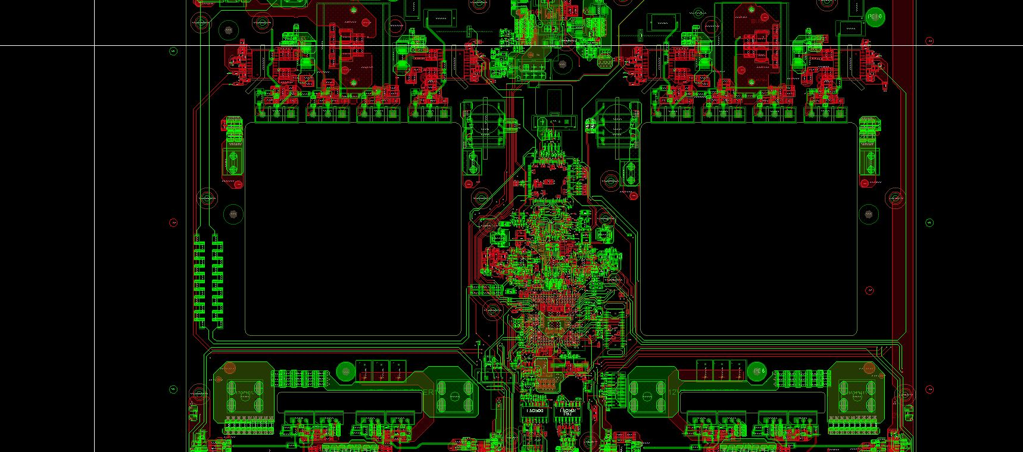
Placement
Avoid from placing fragile components on weak areas like in the picture below:
  Those components may crack.

Slide 31
Placement
Distance between screws to ceramic capacitors and resistors: Preferred 100mil.
The longer side of the board will be more sensitive for bending. While placing MLCC capacitors keep the capacitor length vertical to the most sensitive dimension. If you use stiffener, then the MLCC capacitors should be parallel to the stiffener length.
Big boards (350mm and above) should have handles for production carrying use. Those boards may need stiffeners as well.
Place 3 fiducials on each side of the board no matter if contains SMD components or not. The fiducials should be located at least 2mm from the board edge.
Each board should have 2D Barcodes (BARCODE_2D footprint). Two on Top (SN, PN) and one on Bottom (SN). Barcode size is 5x5mm Minimum. It should be free from silks, vias and conductors. Or empty or on a full non-functional plane . Do not place on a functional plane because we don’t want the copper to be exposed. Do not delete the texts: SN, PN, BARCODE_2D, it helps the machine to recognize the barcode location. Do not forget to update the barcode footprint to the latest version. A square full of silk is not permitted.

Slide 32
Placement
Wave soldering: The distance between component’s pads and body to TH pin annular ring on opposite side:
  Component height <3mm → 120mil.
  Component height 3-6mm → 180mil.
  Component height >6mm → 240mil.
Wave soldering and TH components with pitch smaller than XXXX
  wave direction - The narrow side of the panel meets the wave.
  The narrow side of the pin lines meets the wave.
  The first and last pins should have thieving pads. If the wide side of the component meets the wave, then
  need to add thieving pads to all the pins.

Slide 33
Placement
Thieving pads – Since thieving pads are different for each component and board it will be done manually. The thieving pads size depends on the pad size (not drill).
There are few footprints available at the library for thieving pads:
  Thieving40_20x70 for 40mil pads
  Thieving50_25x90 for 50mil pads
  Thieving60_30x105 for 60mil pads
  Thieving70_35x125 for 70mil pads
  Thieving80_40x140 for 80mil pads

Slide 34
Placement
Robotic soldering: The distance between component’s pads and body to TH pin annular ring on opposite side:
  Component height =<3mm → 100mil.
  Component height >3mm → 160mil.
  While using Robotic soldering thermal reliefs should be done with cross (Not thermal VIAs) for high current as well.

Slide 35
Placement
Laser soldering: The distance between component’s pads and body to TH pin annular ring on opposite side:
  Component height =<40mm → 120mil.
  Component height >40mm → 1380mil (35mm).
  While using Laser soldering thermal reliefs should be done with cross (Not thermal VIAs) for high current as well.
  Laser Soldering requires a special footprint. Pads should be larger than usual on the soldering side only, and white Silkscreen should be applied around the pads to avoid burning of the board.
2* pad length
Silkscreen ink over solder mask
3.5mm
Solder mask ink
1.75mm
2mm

Slide 36
Placement
Press fit components (as per DOC-PR-00474):
  Pin’s plated TH requirements (drill, coating…) must be defined as per MFG requirements.
  Distance between SMD components edge to Press fit component pins center: 5mm.
  Distance between SMD components edge to press fit component mechanic elements which touch the PCB (For example, four towers in IGBT modules) : 2mm.
  Distance between SMD components edge to any surface of the jig which meets the PCB: 2mm.
  Distance between mechanic screws and standoffs on the PCB (which connect the PCB to the Heat sink) to press fit component edge: 50mm.
  Screws and Standoffs should be distributed as symmetrically as possible around the IGBT. A symmetric distribution will assure that the PCB will bend and push the IGBT down evenly against the Heat sink.
  Press fit components should have around them few package keep out areas for the press jig, as per mechanic and Q&R instructions. We should keep 2mm distance between the press jig to SMD components edge.

Slide 37
Placement
Automatic Lines (as per DOC-PR-00700)
  PCB Maximum dimensions: 400mm x 500mm.
  Maximum component height on the top side (C.S): 100mm.
  PCBA Maximum weigh: 4.5kg.
  All screws must be M4. M4 screw drill diameter: 4.8mm (XXXX Footprint).
  Minimize the quantity of screws used in the product wherever feasible.
  Components which may move after assembly (such as Y capacitors…) should have 100mil distance from screws and spacers, to avoid interference during tightening the screws.
  Each board should have 2 holes for guiding pins. One is circle drill (MECH_3_5MM_NP) and the other is Oval drill (MECH_OVAL_3_5MM_4MM_NP). The longer diameter direction of the oval hole should point the circle drill center.

Slide 38
Placement
Automatic Lines
  Each board should have gripping areas:
    Grippers on the board outline: At list 2 grippers should be placed on the two parallel edges of the board. GRIPPER_1 on one side of the board and GRIPPER_2 on the opposite. The maximum distance between two adjacent grippers should be 100mm.
    Using vacuum nipples. Package keep out and Via keep out areas for vacuum nipples. Available footprints are VACUUM_12MM, VACUUM_20MM.
    A combination of Grippers on the outline and vacuum nipples at the middle of the board is acceptable, depending on the board size and weigh.
    Gripping method should be designed with automation representative from the Global Automation division and approved by them.
    Make sure to maintain uniform spacing between the gripping points.

Slide 39
Placement
Automatic Lines
  Each board should have 2D Barcodes (BARCODE_2D footprint). Two on Top (SN, PN) and one on bottom. Barcode size is 5x5mm Minimum. It should be free from silks vias and conductors. Or empty or full plane. A full plane is referred.
  Large and heavy boards may need stiffeners. Need to check with mechanic and OPS (Albert or Benny)
  It is necessary to design the boards with balance of SMD components on TOP and Bottom, as much as possible, to reduce the assembly time. Please check with SMD_INS_report.

Slide 40
Placement approval
Send placement for responsible engineer, Mechanic and technologist for approval.

Slide 41
Routing
Plan your stuck-up in a way that will achieve copper balance. Make sure that you use parallel layers for signal and planes. For example, if you have 6 layers board, top and bottom layers will be signal. L2 and L5 will be planes and L3 and L4 will be signal layers.
Minimum Via drill diameter as per board thickness:
    1.6mm – via20rd9
    2mm – via24rd12
    2.4-3mm – via30rd15
First route the power circuit, then route important signals such as clock, PWM, data, differential signals and then the others.

Slide 42
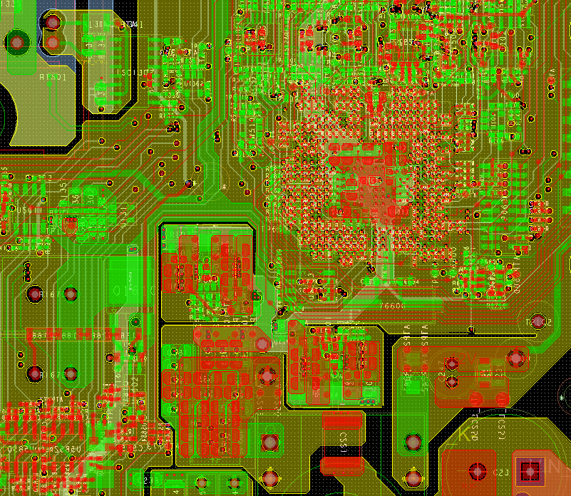
Routing
Make sure each signal is coupled to the right GND plane for the return signal all the way. Do not cross different GND planes threw the way.
Do not overlap different areas of the board, such as power, auxiliary, digital, analog and so on. Make for each one of them its own GND plane and connect them by star in one point.

Slide 43
Routing
Make sure that noisy signals or sensitive signals, which routed in nearby layers are crossing each other and not going on parallel. In this way, their electromagnetic flux will not influence each other.
Make sure that conductors, which are routed in the same layer, have 3W distance between them. It is especially important for noisy and sensitive signals.
Distance between conductors to PCB edge: 40mil.
Minimum trace width is depending on the copper thickness as follows:
  3Oz – 10mil
  2Oz – 8mil
  1Oz – 6mil
  0.5Oz – 5mil
Try to enlarge the indicated width by 2mil in order to gain better yield and price.

Slide 44
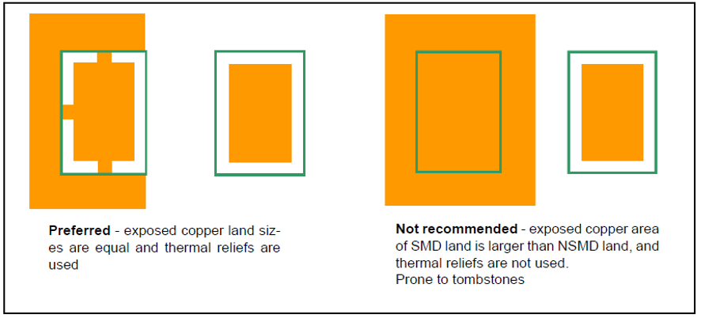
Routing
Discrete components which are smaller than 0603 (Including) should be connected Symmetrically from both pins in order to minimize the tombstone defects. If one pin connected with a trace and the other with shape then thermal relief should be considered. Traces should be attached to the pad at the midpoint, being no more than 1/3rd the pad width. Preferred trace length of 10mils.

Slide 45
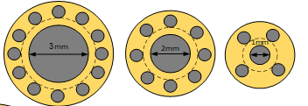
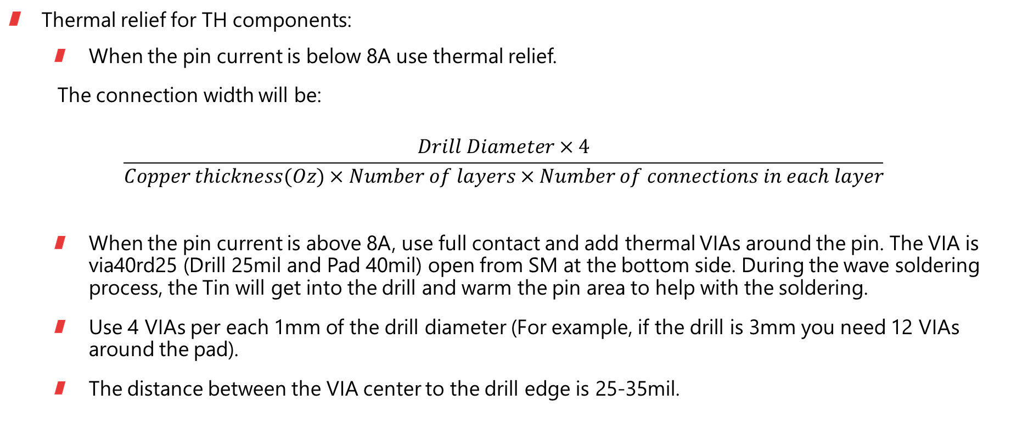
Routing
Thermal relief for TH components:
  When the pin current is below 8A use thermal relief.
  The connection width will be:
  $$\frac{Drill Diameter×4}{Copper thickness(Oz)×Number of layers×Number of connections in each layer}$$
  When the pin current is above 8A, use full contact and add thermal VIAs around the pin. The VIA is via40rd25 (Drill 25mil and Pad 40mil) open from SM at the bottom side. During the wave soldering process, the Tin will get into the drill and warm the pin area to help with the soldering.
  Use 4 VIAs per each 1mm of the drill diameter (For example, if the drill is 3mm you need 12 VIAs around the pad).
  The distance between the VIA center to the drill edge is 25-35mil.

Slide 46
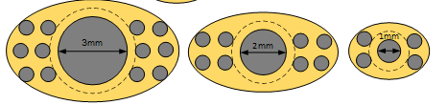
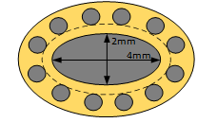
Routing
  In case the VIAs is damaging the high current planes place them in a nonsymmetrical way which will damage the less.
  For ellipsoid hole with D1 and D2 diameters, use 2x(D1+D2) VIAs around the pad.

Slide 47
Routing
Do not connect TH components to more than 4 layers unless needed.
Via minimal size is VIA_20RD9 (drill 9mil, pad 20mil). Larger Vias are preferred (like VIA_24RD12).
Maximum current flow through via VIA_20RD9 is 0.5A.
Distance between Via solder mask opening to Pad same net – at least 4mil.
VIA solder mask covering:
  All VIAs of 15mil drill and below should be SM plug in and covered with solder mask from both sides.
  VIAS which are above15mil drill, should have solder mask opening from both sides with drill+4mil diameter.
  ICT VIAs will be 12mil and above drill diameter, with solder mask opening from both sides of drill+4mil diameter.

Slide 48
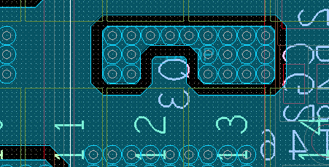
Routing
When you use multiple via for high current, please place a plane to short and cover all the VIAs on each layer.

Slide 49
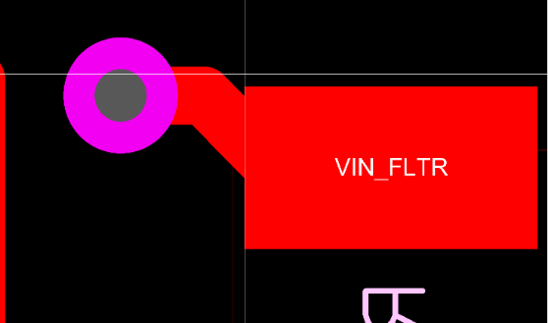
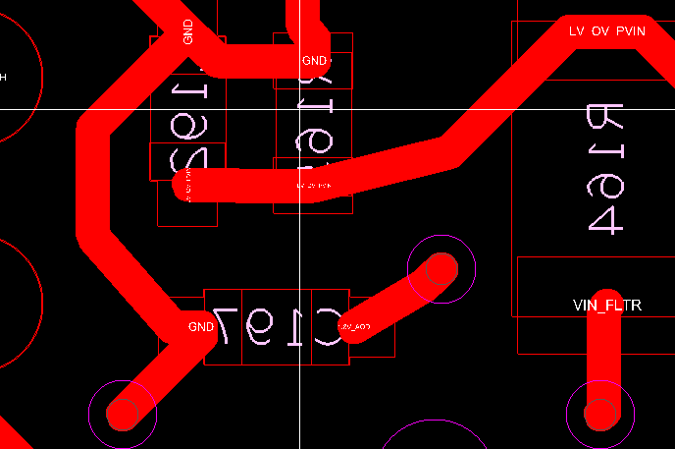
Routing
Tracks routing angels should not be less than 90°. Make sure that you do not create degrees that are smaller than 90° between pads and wires.
Do not route conductors in a direction that is not 45°.

Slide 50
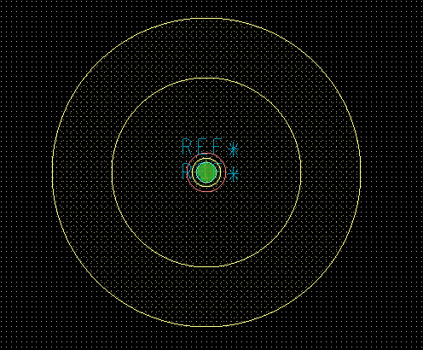
ATE
ATE Pads should have at least 40mil diameter.
There are few footprints available of ATE TPs: ATE_TP_40, ATE_TP_60, ATE_TP_80, ATE_TP_120 and ATE_TP_160.
Please place all ATE TPs on the same side of the board. Bottom side is preferred.
You should keep 120mil between ATE TPs and TH pins on bottom side.
You should keep 80mil distance between ATE_TP_40, ATE_TP_60 centers. 90mil distance between ATE_TP_80 centers, and 320mil between ATE_TP_120 and ATE_TP_160 centers. You should keep 200mil distance between small ATE TPs centers to the large ATE TPs centers.
On the ATE TPs footprints, there are Package Keepout planes in order to keep distance between ATE TPs to high components.

Slide 51
ATE
If you use TPs for other use than ATE please use other footprint (SMT_TP_1 for example), so they will not appear on the ATE layer.
Please add component Keepouts on each side of the board. On the ATE TPs side (Usually bottom) use KEEPOUT-5_6 footprint and on the other side (Usually top) use KEEPOUT-3_1 footprint.
You should disperse them on your board. Please locate more keepouts where there is an ATE TPs concentration. Minimum 4 keepouts allowed on each side of the board.
If possible, please locate 2-3 locating pins with maximum distance between them. The drill diameter should be 3.5mm (MECH_3_5MM_NP footprint).
The distance between the locating pins to ATE TPs or conductors have to be minimum 3mm.
Please verify that you do not have any high component close to ATE TP as per package keepout area around each TP.

Slide 52
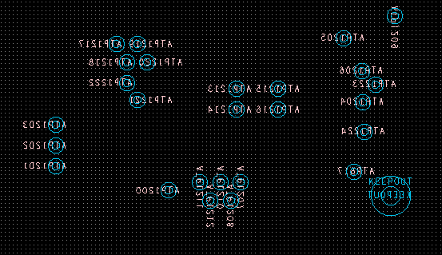
ATE
Please verify that the ATE TPs have the right distance between them. There is a circle around each ATE TP at the ATE Gerber. Please make sure that those circles do not overlap each other.

Slide 53
ICT
We aim for 100% coverage of ICT. Not less than 90% from the allowed nets.
There are some signals that are not approved for stubs and longer lines such as clock, PWM and sensitive signals that can be damaged by it. Those signals will not be counted on the coverage if you will give them NO_TEST property in the DSN.
ICT can be implemented on both sides of the board, but bottom side is preferred.
ICT point should be numbered as ICT1, ICT2, …
ICT Pads and Vias should have 35mil diameter.
ICT Pads are ICT35SMT_TOP for top layer and ICT35SMT_BOTTOM for bottom layer.
ICT VIAs are VIA_XXRDXX_ICT _TOP for top layer and VIA_XXRDXX_ICT _BOTTOM for bottom layer.
ICT VIAs will be 12mil drill diameter and above.

Slide 54
ICT
Distance between ICT TPs centers: 55mil.
For no clean process: Distance from ICT TPs to SMD component’s pads 16mil.
Minimum distance from ICT TP to TH pin on bottom – 120mil.
Distance from high components:
Component height (mm) | Distance (mm) | Distance (mil)
0-3 | 0.4 | 12
3-5 | 1.5 | 60
5-8 | 2.7 | 107
8-12 | 3.2 | 126
12-16 | 3.7 | 146
16-20 | 4.2 | 166
20-30 | 4.7 | 185
30 and above | 6 | 237

Slide 55
ICT
Setting the ICT points:
  Set all TPs as ICT points.
  Change existing Vias to ICT Vias.
  Add ICT Pads on traces and shapes on the outer layers.
  Set TH pins as ICT points.
  Add Vias or ICT Pads on the nets that left without ICT. Please check with the board designer to verify whether he allows stubs or not and take care of sensitive signals.
GND and power planes should have more than one ICT TP (one TP per 0.5A).
Do not place ICT TP surrounded with TH pins because they may be soldered in the wave soldering process.
Try to minimize the using of TH pins as ICT TPs.
While using flying probe machines for ICT tests:
  better not to use ICT vias. ICT pads are better.
  Use filled and capped vias.

Slide 56
Panelization
Maximum panel size is 400mm x 500mm. Even for single board.
If there are component, which are less than 5mm from edge of PCB, tooling bars must be added. If there are no SMT components, which are less than 5mm from edge of PCB there is no need for tooling bars.
The tooling bars should be placed at two opposite sides of the panel. If additional Mechanical strength needed, add full frame of tooling bar. A full frame is preferred.
The tooling bars width need to be 5mm width (200mil). If there are components which are protruding out of the board outline the tooling bars should be enlarged to be 200mil from the component edge.
The tooling bars will be connected to the board by tabs (KIRSUM_24_NO_HOLES footprint). 2.4mm without mice bites. The distance between the tabs should be no more than 50mm.
If you have more than one board on a panel, make sure that the tabs location for each board on the panel is identical.

Slide 57
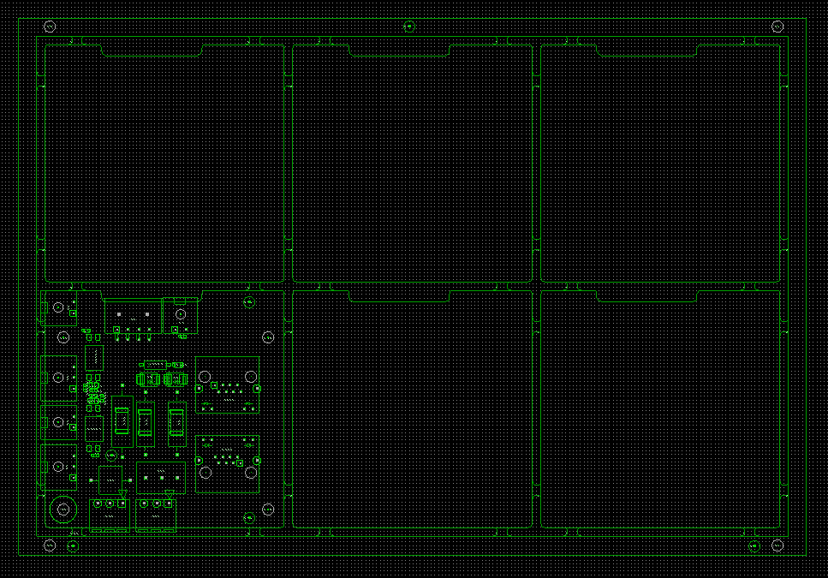
Panelization
Please make sure that the tabs are not placed in front of MLCC (Ceramic capacitors), Crystal clock and edge connectors. A 200mil distance is needed.
Do not place tabs under components which protruding from the board edge.
The utilization of the panel including all rulers and orientation should fit to working panel of 22x46”. Coverage needs to be higher than 75%. Better to send the board for technologist for panelization recommendation.
Mark on each board its rotation related to the main board.
Number the boards in the Silkscreen layer.

Slide 58
Panelization
On the panel, please place 3 fiducials on each side of the board no matter if contains SMD components or not. The fiducials should be as far as possible one from the others.
On the panel, please locate 4 locating pins with maximum distance between them. The drill diameter should be 2.5mm (MECH_2_5MM_NP footprint). The locating pins should be asymmetrical for the “Poke-Yoke“ fixture. Those holes use for some manufacturing processes.
PCBs which contains only TH components do not need panelization and rulers.
All our boards need to be with tabs for router and not Vcut unless other approval from QnR. However, if you chose to use Vcut, you should mark each Vcut line. In addition, you need to keep 200mil from components to the edge of the board.

Slide 59
Production files
Production files will be done only after designer, mechanic, technologist, and ATE approval.

Slide 60
Approvals
Placement approval – Please attach the files:
  BRD file
  ASSY_CS.dxf
  ASSY_PS.dxf
  emn, emp files
  Approvers: Responsible engineer and team leader, Mechanic, Albert, Benny.
Routing approval – Please attach the files:
  BRD file
  Approvers: Responsible engineer and team leader.

Slide 61
Approvals
Final approval – Please attach the files:
  BRD file
  ASSY_CS.dxf
  ASSY_PS.dxf
  ATE_dxf
  Drill.dxf
  emn, emp files
  ODB++
  BOM (Responsible engineer)
  DOC-SP (Responsible engineer)
  Approvers: Responsible engineer and team leader, Mechanic, Albert, Benny ,Naif A, ShaulY.

